Slide 1
Lecture 1: Supplemental materials
Tom Jhou

Slide 2
A few things I didn’t mention Monday (but should have):
How to debug using breakpoints
How numpy calculates means
Standard deviation vs standard error

Slide 3
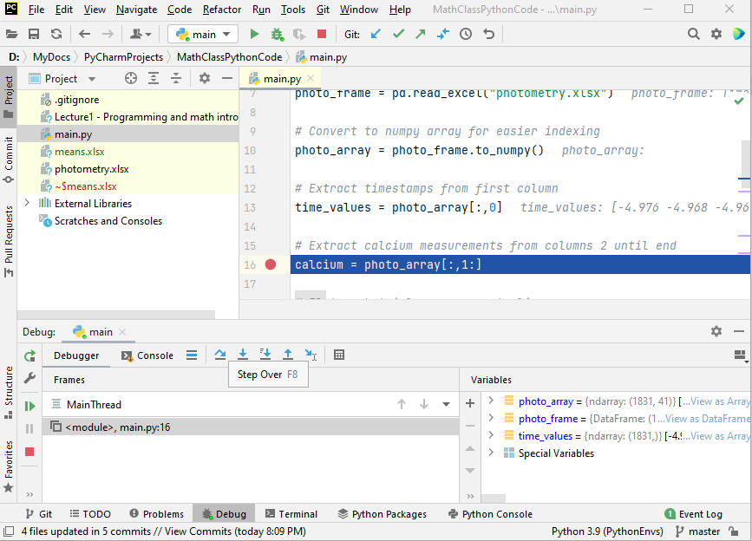
Breakpoints:
#2 start debug mode by clicking bug icon
#1 click to set breakpoint (red dot)
#3 code runs until breakpoint (line 16)

Slide 4
Breakpoints:
#4 step one line at a time with “step over”
#5 inspect variables at each step

Slide 5
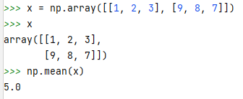
numpy.mean()
5
Averages all values into a single value.

Slide 6
How to find row/column means?
Remember: with matrices, vertical dimension is ALWAYS first (0th in Python)
This is backwards from Cartesian where horizontal (x) dimension is first.
It’s been like that for > 100 years.

Slide 7
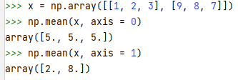
Column mean, use “axis=0”

Slide 8
Row mean, “axis = 1”

Slide 9
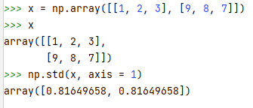
numpy has a standard deviation function (np.std) that works a lot like np.mean()

Slide 10
Standard error vs Standard deviation:
Standard error = standard deviation divided by square root of sample size N.
But why?
And why is “standard error”, i.e. SE, often called “standard error of the mean”, i.e. SEM?

Slide 11
Let’s take an example question:
Question: what is the average height of an adult female in America?
Method 1: Measure all 169 million women in America, take average.
Obviously not practical.
Method 2: measure a smaller sample. Take average.
This is what researchers actually do.
But what size sample is enough? 10? 100? 1000?

Slide 12
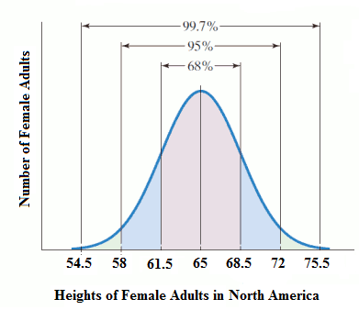
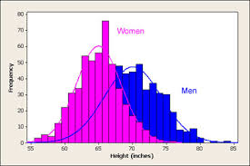
Compare bell curve from 169 million people versus bell curve from 500.
169 million women
Mean is here.
~500 women
Obviously, bell curve is a little messy, due to random variation. But 500 is a decent size sample, so mean is probably pretty accurate.
But how accurate?
If you took an entirely different sample of 500 people, how much will the mean vary from sample to sample?

Slide 13
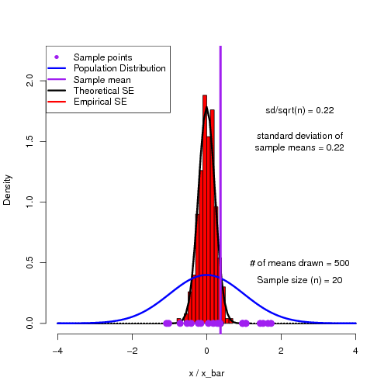
If you repeat experiment over and over with independent subsamples, means will form a second bell curve.
Distribution of means of each replication
Original population

Slide 14
This new Gaussian’s standard deviation = “standard error” (of the mean)
Standard error of the mean (SEM) = standard deviation (SD) of this Gaussian.

Slide 15
S.D. versus S.E.M.
~68% chance an individual’s height is in this range (mean plus/minus one S.D.)
~68% chance that true mean (which we can’t measure directly) is in this range (sample mean ± 1 S.E.M.)

Slide 16
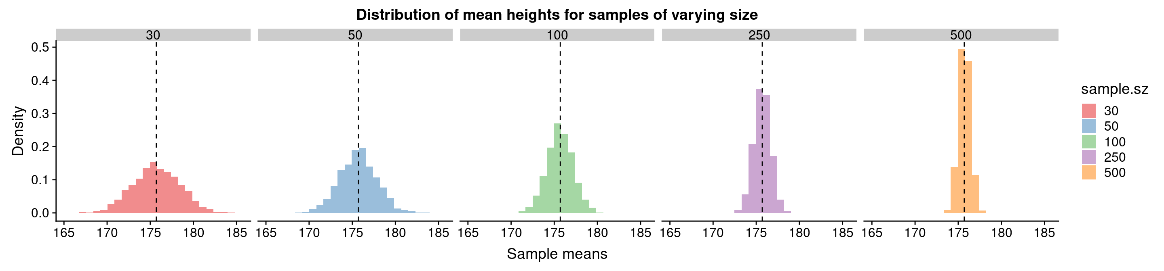
Bigger sample size N makes narrower Gaussians, and smaller SEM = SD / sqrt(N)

